Slide 1
Chapter 10
Practical Database Design Methodology and Use of UML Diagrams

Slide 2
Chapter 10 Outline
The Role of Information Systems in Organizations
The Database Design
and Implementation Process
Use of UML Diagrams as an Aid to Database Design Specification
Rational Rose: A UML-Based Design Tool
Automated Database Design Tools
Notes:
Database design is the process of producing a detailed data model of database.

Slide 3
Practical Database Design
Methodology and Use of UML Diagrams
Design methodology
  Target database managed by some type of database management system
Various design methodologies
Large database
  Several dozen gigabytes of data and a schema with more than 30 or 40 distinct entity types

Slide 4
The Role of Information Systems in Organizations
Organizational context for using database systems
  Organizations have created the position of database administrator (DBA) and database administration departments
  Information technology (IT) and information resource management (IRM) departments
    Key to successful business management
Notes:
In a large organization, the database system is typically part of an information system (IS), which includes all resources that are involved in the collection, management, use, and dissemination of the information resources of the organization

Slide 5
The Role of Information Systems in Organizations (cont’d.)
  Database systems are integral components in computer-based information systems
  Personal computers and database system-like software products
    Utilized by users who previously belonged to the category of casual and occasional database users
  Personal databases gaining popularity
  Databases are distributed over multiple computer systems
    Better local control and faster local processing

Slide 6
The Information System Life Cycle
Information system (IS)
  Resources involved in collection, management, use, and dissemination of information resources of organization

Slide 7
The Information System Life Cycle
The information system life cycle:
  Feasibility analysis
  Requirements collection and analysis
  Design
  Implementation
  Validation and acceptance testing
  Deployment, operation, and maintenance
Notes:
Feasibility analysis : This phase is concerned with analyzing potential application areas and, performing primary cost-benefit studies, determining the complexity of data and processes, and setting up priorities among applications.
Requirements collection and analysis: Detailed requirements are collected by interacting with potential users and user groups to identify their particular problems and needs.
Design: This phase has two aspects: the design of the database system and the design of the application systems (programs) that use and process the database through retrievals and updates.
Implementation: The information system is implemented, the database is loaded, and the database transactions are implemented and tested.
Validation and acceptance testing: The acceptability of the system in meeting users’ requirements and performance criteria is validated. The system is tested against performance criteria and behavior specifications.
Deployment, operation, and maintenance: Monitoring of system performance and system maintenance are important activities during the operational phase

Slide 8
The Information System Life Cycle (cont’d.)
The database application system life cycle:
  System definition
    The scope of the database system, its users, and its applications are defined
  Database design
    A complete logical and physical design of the database system on the chosen DBMS is prepared
  Database implementation
    Creating the (empty) database files, and implementing the software applications
  Loading or data conversion
    The database is populated either by loading the data directly or by converting existing files into the database system format

Slide 9
The Information System Life Cycle (cont’d.)
  Application conversion
    Any software applications from a previous system are converted to the new system
  Testing and validation
    The new system is tested and validated; There are automated tools that assist in this process.
  Operation
    The database system and its applications are put into operation. Usually, the old and the new systems are operated in parallel for a period of time
  Monitoring and maintenance
    During the operational phase, the system is constantly monitored and maintained

Slide 10
The Database Design and Implementation Process
Design logical and physical structure of one or more databases:
  Accommodate the information needs of the users in an organization for a defined set of applications
Goals of database design
  Very hard to accomplish and measure
Often begins with informal and incomplete requirements
Notes:
The Goals of database design :
1. Satisfy the information content requirements of the specified users and applications.
2. Provide a natural and easy-to-understand structuring of the information
3. Support processing requirements and any performance objectives, such as response time, processing time, and storage space

Slide 11
The Database Design and Implementation Process (cont’d.)
Main phases of the overall database design and implementation process:
  1. Requirements collection and analysis
  2. Conceptual database design
  3. Choice of a DBMS
  4. Data model mapping (also called logical database design)
  5. Physical database design
  6. Database system implementation and tuning
Notes:
Conceptual database design : For conceptual schema design, we must identify the basic components of the schema: the entity types, relationship types, and attributes. We should also specify key attributes, cardinality and participation constraints on relationships, weak entity types, and specialization/ generalization.
Choice of a DBMS : depends on several factors including : technical, costs (hardware, software, data conversion, etc.), and others concerned with the politics of the organization
Data Model Mapping : we map (or transform) the conceptual schema from the high-level data model used in Phase 2 into the data model of the chosen DBMS.
Physical database design translates the logical data model into a set of SQL statements that define the database. For relational database systems, it is relatively easy to translate from a logical data model into a physical database. Rules for translation: Entities become tables in the physical database
Database Implementation: During this phase, the database and application programs are implemented, tested, and eventually deployed for service

Slide 12
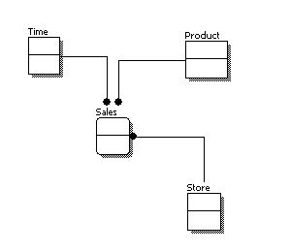
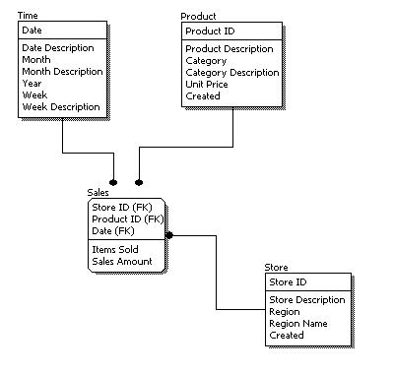
Conceptual, Logical, and Physical design
Conceptual Model Design
Logical Model Design
Notes:
In general

Slide 13
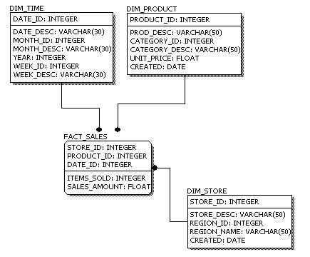
Conceptual, Logical, and Physical design (cont’d.)
Physical Model Design
Notes:
This is why we always first start with the conceptual data model (so we understand at high level what are the different entities in our data and how they relate to one another), then move on to the logical data model (so we understand the details of our data without worrying about how they will actually implemented), and finally the physical data model (so we know exactly how to implement our data model in the database of choice).

Slide 14
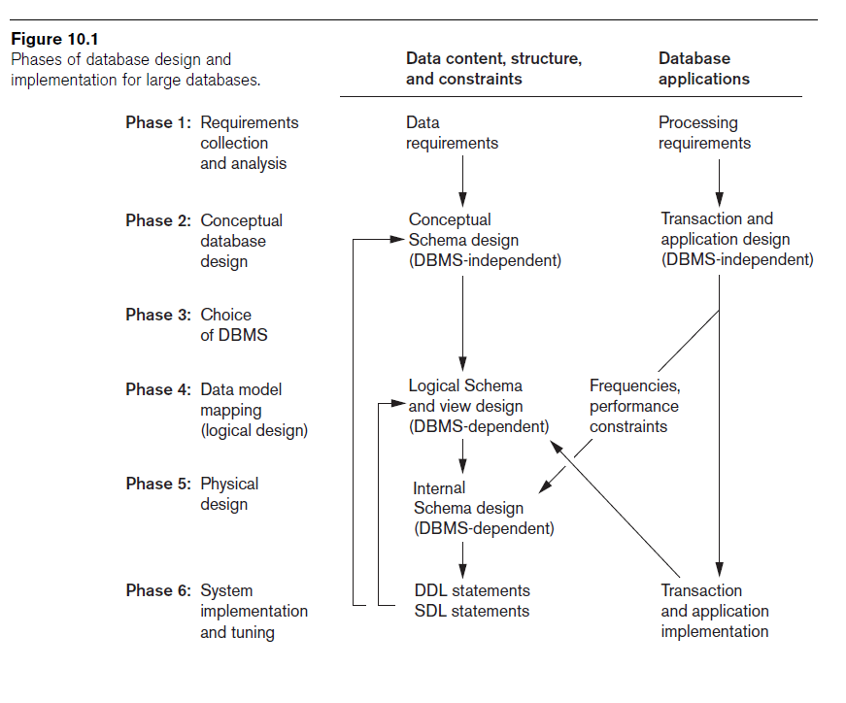
Database design
Software design
Notes:
Parallel activities : Data content, structure, and constraints AND database applications
The six phases mentioned previously do not typically progress strictly in sequence. In many cases we may have to modify the design from an earlier phase during a later phase.
These feedback loops among phases—and also within phases—are common. We show only a couple of feedback loops in this Figure, but many more exist between various phases.
Clearly, these two activities (first and second columns) strongly influence one another. Traditionally, database design methodologies have primarily focused on the first of these activities whereas software design has focused on the second; this may be called data-driven versus process-driven design.

Slide 15
The Database Design and Implementation Process (cont’d.)
Parallel activities
  Data content, structure, and constraints of the database
  Design of database applications
Data-driven versus process-driven design
Feedback loops among phases and within phases are common
Notes:
The six phases mentioned previously do not typically progress strictly in sequence. In many cases we may have to modify the design from an earlier phase during a later phase. These feedback loops among phases—and also within phases—are common. We show only a couple of feedback loops in this Figure, but many more exist between various phases.
Clearly, these two activities strongly influence one another. Traditionally, database design methodologies have primarily focused on the first of these activities whereas software design has focused on the second; this may be called data-driven versus process-driven design.

Slide 16
The Database Design and Implementation Process (cont’d.)
Heart of the database design process
  Conceptual database design (Phase 2)
  Data model mapping (Phase 4)
  Physical database design (Phase 5)
  Database system implementation and tuning (Phase 6)

Slide 17
Phase 1: Requirements Collection and Analysis
Activities
  Identify application areas and user groups
  Study and analyze documentation
  Study current operating environment
  Collect written responses from users

Slide 18
Phase 1 (cont’d.)
Requirements specification techniques
  Object Oriented analysis (OOA)
  Data flow diagrams (DFDs)
  Refinement of application goals
  Computer-aided

Slide 19
Phase 2: Conceptual Database Design
Phase 2a: Conceptual Schema Design
  Important to use a conceptual high-level data model
Strategies for schema design
    Top-down strategy
    Bottom-up strategy
    Inside-out strategy
    Mixed strategy
Notes:
Inside-out strategy : This is a special case of a top-down strategy, where attention is focused on a central set of concepts that are most evident. We could specify a few clearly evident entity types in the schema and continue by adding other entity types and relationships that are related to each.

Slide 20
Phase 2: (cont’d.)
Phase 2b: Transaction Design
  In parallel with Phase 2a
  Specify transactions at a conceptual level
  Identify input/output and functional behavior

Slide 21
Phase 3: Choice of a DBMS
Costs to consider
  Software acquisition cost
  Maintenance cost
  Hardware acquisition cost
  Database creation and conversion cost
  Personnel cost
  Training cost
  Operating cost
Consider DBMS portability among different types of hardware

Slide 22
Phase 4: Data Model Mapping
(Logical Database Design)
Create a conceptual schema and external schemas
  In data model of selected DBMS
Stages
  System-independent mapping
  Tailoring schemas to a specific DBMS
Notes:
?????????

Slide 23
Phase 5: Physical Database Design
Choose specific file storage structures and access paths for the database files
  Achieve good performance
Criteria used to guide choice of physical database design options:
  Response time
  Space utilization
  Transaction throughput

Slide 24
Phase 6: Database System Implementation and Tuning
Typically responsibility of the DBA
  Compose DDL
  Load database
  Convert data from earlier systems
Database programs implemented by application programmers
Most systems include monitoring utility to collect performance statistics

Slide 25
Use of UML Diagrams as an Aid to Database Design Specification
Use UML as a design specification standard
Unified Modeling Language (UML) approach
  Combines commonly accepted concepts from many object-oriented (O-O) methods and methodologies
  Includes use case diagrams, sequence diagrams, and statechart diagrams

Slide 26
UML for Database Application Design
Advantages of UML
  Resulting models can be used to design relational, object-oriented, or object-relational databases
  Brings traditional database modelers, analysts, and designers together with software application developers

Slide 27
Different Types of Diagrams in UML
Structural diagrams
  Class diagrams and package diagrams
  Object diagrams
  Component diagrams
  Deployment diagrams

Slide 28
Different Types of Diagrams in UML (cont’d.)
Behavioral diagrams
  Use case diagrams
  Sequence diagrams
  Collaboration diagrams
  Statechart diagrams
  Activity diagrams

Slide 29
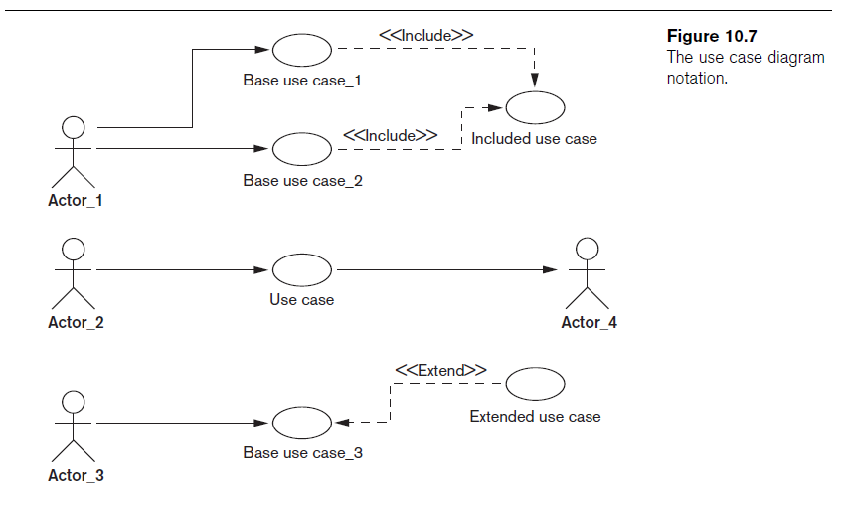

Slide 30
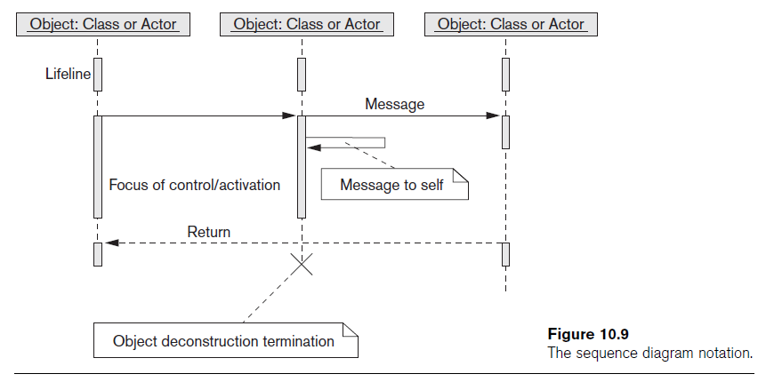
Different Types of Diagrams in UML (cont’d.)

Slide 31
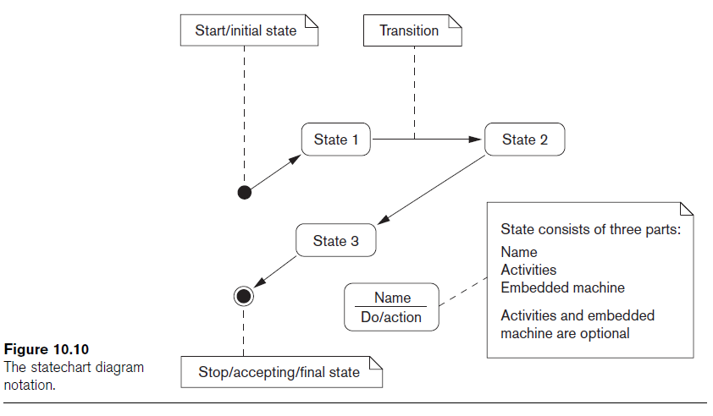
Different Types of Diagrams in UML (cont’d.)

Slide 32
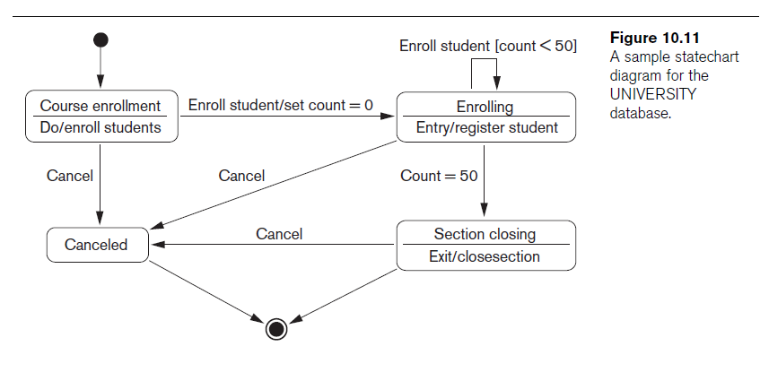
Modeling and Design Example: UNIVERSITY Database
Notes:
Initial state = black filled circle
Final state = black filled circle with a circle around
States are represented by boxes.
Lines are the events.

Slide 33
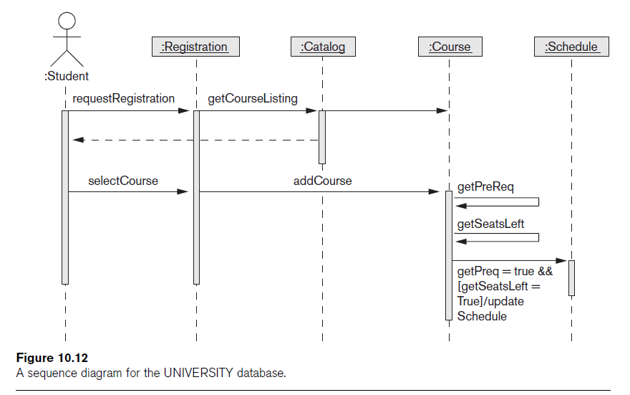
Notes:
Top to bottom = time
Actor : Someone or something outside the system that interacts with the use cases in the system
As we define our entities (or objects), the lined below them are dashed lines and are called lifeline (in UML).
Define who will initiate the interaction (Student in this example)
Message (to the subsystem) – Actor to subsystem
Messages to other subsystems – Sub-system to other sub-systems.
Draw return message to the actor
[send/response] to another actor (e. g. Send SMS)

Slide 34
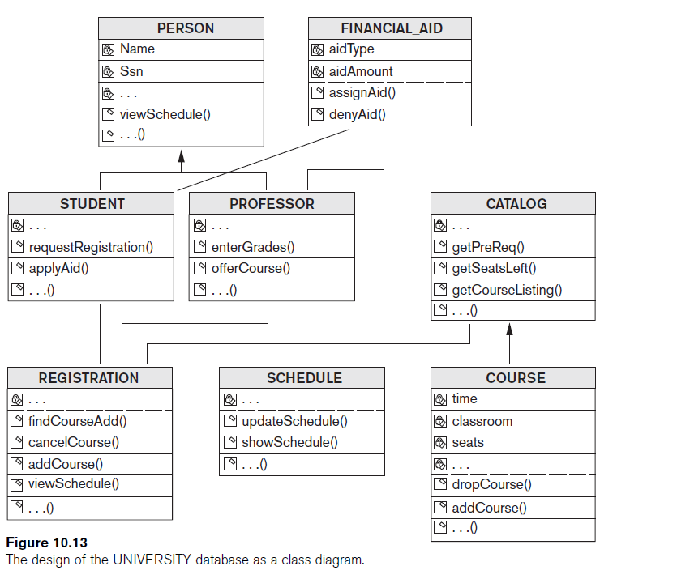
Notes:
Attributes [with their types]
Methods

Slide 35
Rational Rose: A UML-Based Design Tool
Rational Rose for database design
  Modeling tool used in the industry to develop information systems
Rational Rose data modeler
  Visual modeling tool for designing databases
  Provides capability to:
    Forward engineer a database
    Reverse engineer an existing implemented database into conceptual design

Slide 36
Data Modeling Using Rational Rose Data Modeler
Reverse engineering
  Allows the user to create a conceptual data model based on an existing database schema specified in a DDL file
Forward engineering and DDL generation
  Create a data model directly from scratch in Rose
  Generate DDL for a specific DBMS
Notes:
Data Model

Slide 37
Data Modeling Using Rational Rose Data Modeler (cont’d.)
Conceptual design in UML notation
  Build ER diagrams using class diagrams in Rational Rose
  Identifying relationships
    Object in a child class cannot exist without a corresponding parent object
  Non-identifying relationships
    Specify a regular association (relationship) between two independent classes

Slide 38
Data Modeling Using Rational Rose Data Modeler (cont’d.)
Converting logical data model to object model and vice versa
  Logical data model can be converted to an object model
  Allows a deep understanding of relationships between conceptual and implementation models
Notes:
An object model is part of the object-oriented programming (OOP) lifecycle

Slide 39
Data Modeling Using Rational Rose Data Modeler (cont’d.)
Synchronization between the conceptual design and the actual database
Extensive domain support
  Create a standard set of user-defined data types
Easy communication among design teams
  Application developer can access both the object and data models

Slide 40
Automated Database Design Tools
Many CASE (computer-aided software engineering) tools for database design
Combination of the following facilities
  Diagramming
  Model mapping
  Design normalization

Slide 41
Automated Database Design Tools (cont’d.)
Characteristics that a good design tool should possess:
  Easy-to-use interface
  Analytical components
  Heuristic components
  Trade-off analysis
  Display of design results
  Design verification

Slide 42
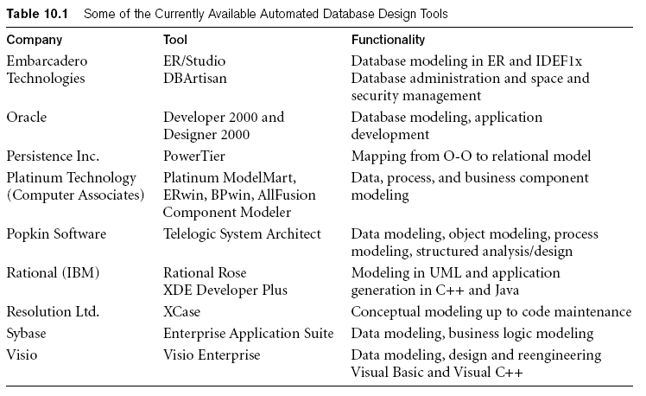
Automated Database Design Tools (cont’d.)
Variety of products available
  Some use expert system technology

Slide 43
Summary
Six phases of the design process
  Commonly include conceptual design, logical design (data model mapping), physical design
UML diagrams
  Aid specification of database models and design
Rational Rose and the Rose Data Modeler
  Provide support for the conceptual design and logical design phases of database design

